Slide 1

AI-Powered Adaptive Disaster Management and Intelligent Evacuation Route Recommendation System
Team Members:
2420090047 – Akshaya Vangalapudi
2420030040 – Mikkineni Thanvitha
2420030017 – Allam Greshmica
Guide: G. Lavanya
Department of CSE
A.Y. 2026–2027

Slide 2
Problem Statement
During disasters, road conditions, hazard locations, and crowd density can change rapidly, making safe evacuation difficult.
Existing evacuation approaches may not simultaneously consider these changing factors while recommending routes.
Therefore, an intelligent and adaptive system is required to recommend safer evacuation routes based on current disaster conditions.

Slide 3
Objectives
1. Disaster Condition Analysis
To analyze disaster conditions and identify potential hazards.
2. Intelligent Evacuation
To recommend safer evacuation routes using AI-based analysis.
3. Adaptive Route Recommendation
To dynamically update routes based on blocked roads, crowd density and hazard locations.
4. Improved Decision Support
To assist authorities and individuals in making faster and safer evacuation decisions.

Slide 4
Existing System
Recent research has developed intelligent and adaptive evacuation methods, but different studies focus on different aspects of the problem.
Research Paper:
“Adaptive Emergency Evacuation Routing: A Graph-Based Approach”
Authors: Hojat Behrooz, Mohammad Ilbeigi
Journal: International Journal of Transportation Science and Technology
Year: 2025
Approach Used:
Uses a dynamic graph-based algorithm for emergency evacuation.
Dynamically adjusts road-segment directions and traffic flow.
Routes evacuees from dangerous zones to safe zones.
Evaluated using a real-world road network in Hoboken, New Jersey.
Key Limitation:
The study primarily focuses on road-network configuration and traffic-flow optimization for vehicle evacuation.

Slide 5
Research Gap / Limitations
Research Gap
Existing research demonstrates that evacuation routes can be dynamically optimized, but there is scope for integrating multiple real-time factors into a single evacuation recommendation system.
Existing Research | Gap
Dynamic road-network adaptation | Does not form our proposed unified user-facing system
Traffic-flow optimization | Limited scope for individual evacuation guidance
Dangerous → safe zone routing | Additional factors can be integrated
Dynamic routing | Scope to combine hazard, blocked-route and crowd information
How Our Project Addresses the Gap
Our system integrates:
Hazard Locations + Blocked Routes + Crowd Density + Current Location
↓
AI-Based Adaptive Route Recommendation
↓
Safer Evacuation Guidance

Slide 6
Proposed System
Our system proposes an AI-powered adaptive disaster management and evacuation recommendation platform that integrates multiple disaster-related factors to recommend safer evacuation routes.
It considers:
Hazard Locations
Where dangerous areas are located.
Blocked Routes
Roads that cannot be used for evacuation.
Crowd Density
Areas with higher evacuation congestion.
Current Location
Location from which the user needs evacuation guidance.
Safe Zones
Available safer destinations.
Output:
Adaptive & Safer Evacuation Route Recommendation

Slide 7
Existing vs Proposed
Existing Research / Systems | Proposed System
Focus may be on a specific evacuation factor | Combines multiple factors
Dynamic road-network optimization | Adaptive route recommendation
Traffic-flow focused approaches | Hazard + road + crowd considerations
Research-oriented/simulation environments | User-oriented application
Separate information sources | Unified disaster management interface
Route planning | Route recommendation + disaster information

Slide 8
Technologies Used
Modern Tools & Technologies:
Jira
Scrum
GitHub
Figma
Google Gemini
GitHub Copilot

Slide 9
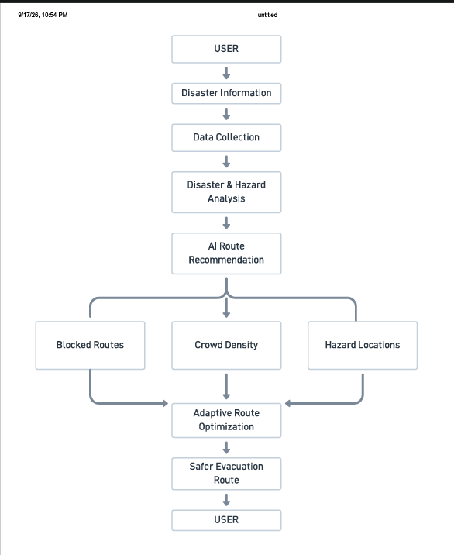
System Architecture

Slide 10
Modules
1. User & Authentication Module
Handles login and user interaction.
2. Disaster Information Module
Provides disaster-related conditions and affected-area information.
3. Hazard Detection Module
Identifies hazardous locations.
4. Route Status Module
Identifies available and blocked routes.
5. Crowd Density Module
Considers crowd/congestion levels.
6. AI Route Recommendation Module
Analyzes the available factors and recommends a suitable evacuation route.
7. Adaptive Route Update Module
Updates the recommendation when disaster conditions change.
8. Map & Visualization Module
Displays hazards, routes, safe zones and evacuation guidance.

Slide 11
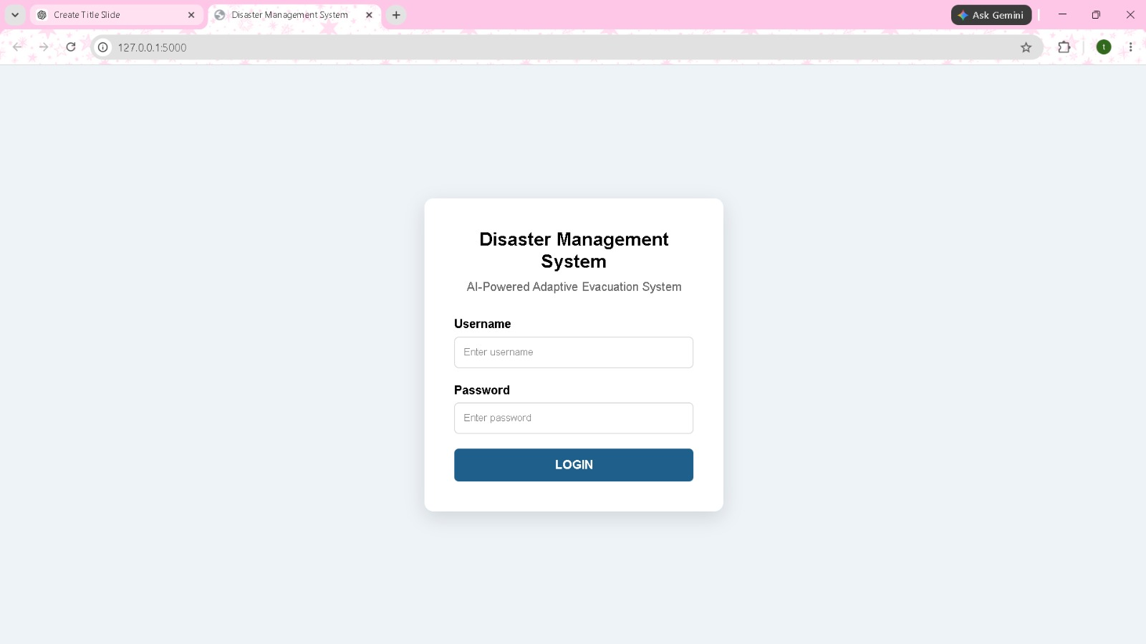
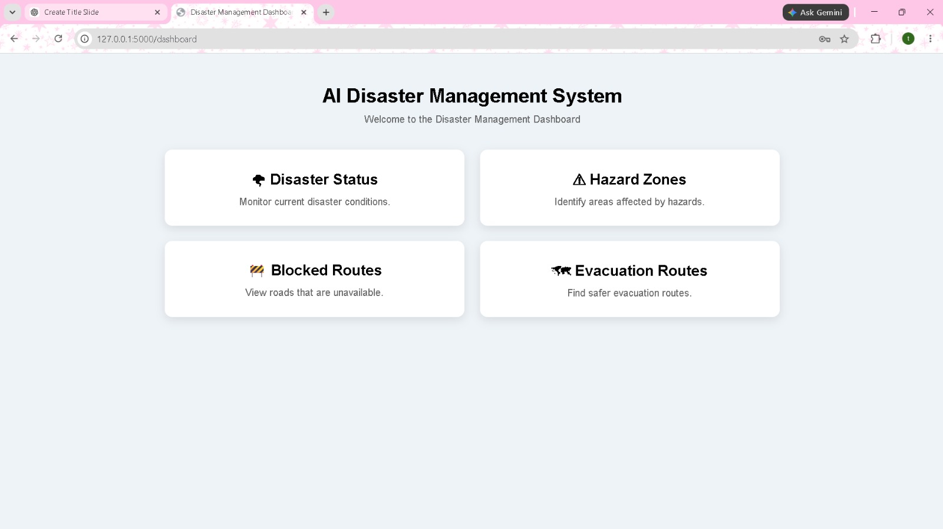
Implementation / Progress

Slide 12
Conclusion
The proposed system aims to address the limitations of conventional and single-factor evacuation approaches by integrating disaster conditions, hazard locations, blocked routes and crowd density into an adaptive evacuation recommendation system. The project applies AI and adaptive software engineering principles to support faster and more informed evacuation decisions.

Slide 13


